Slide 1
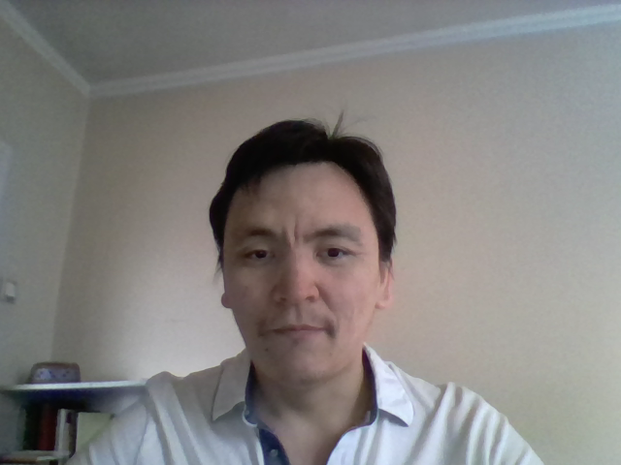
Mindmup on Vue
https://codesandbox.io/s/charming-swirles-gyok8

Slide 2
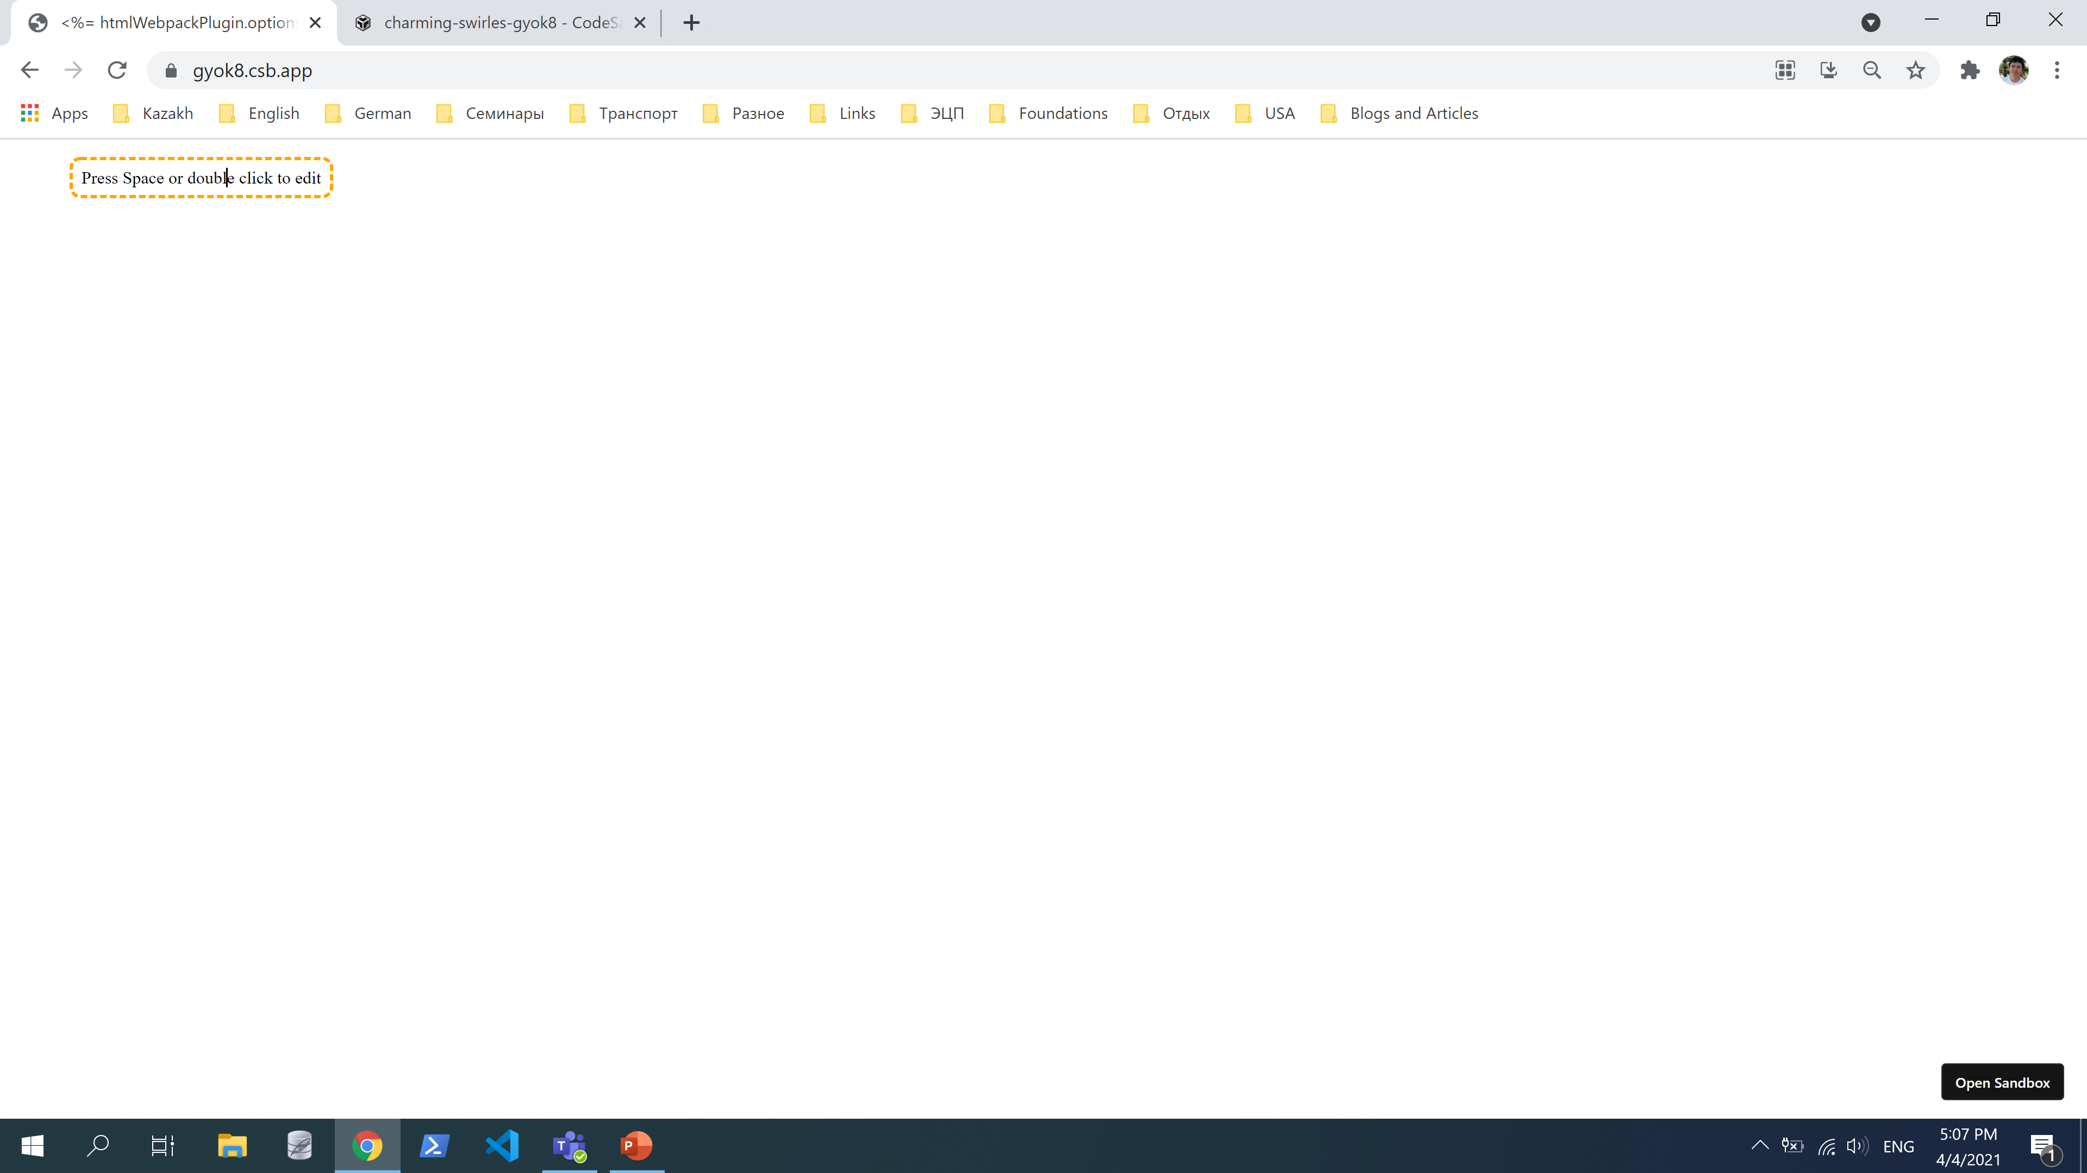
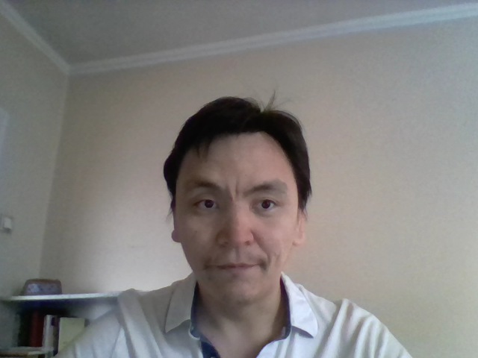

Edit node using keyboard Space key or mouse double click on node

Slide 3
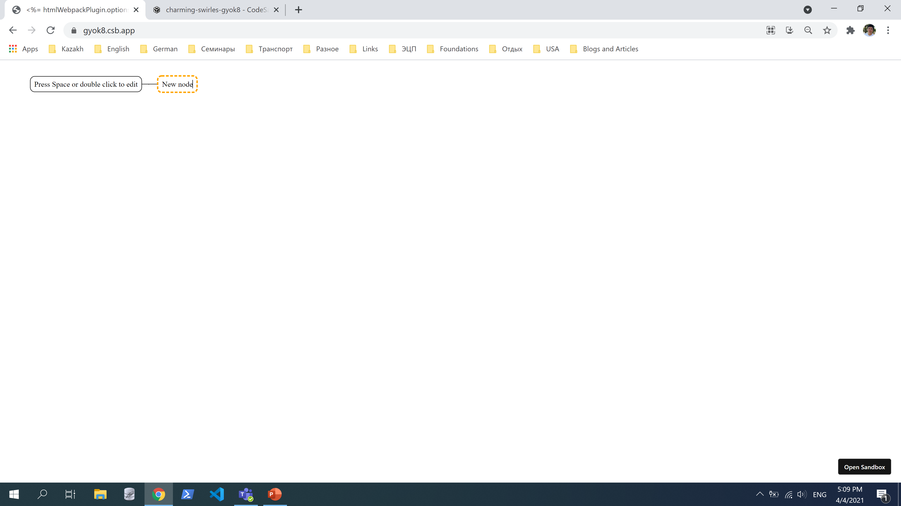
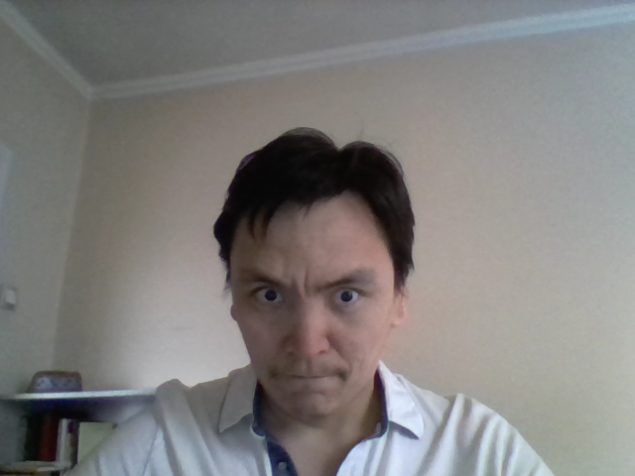
Create child nodes using keyboard Tab key

Slide 4
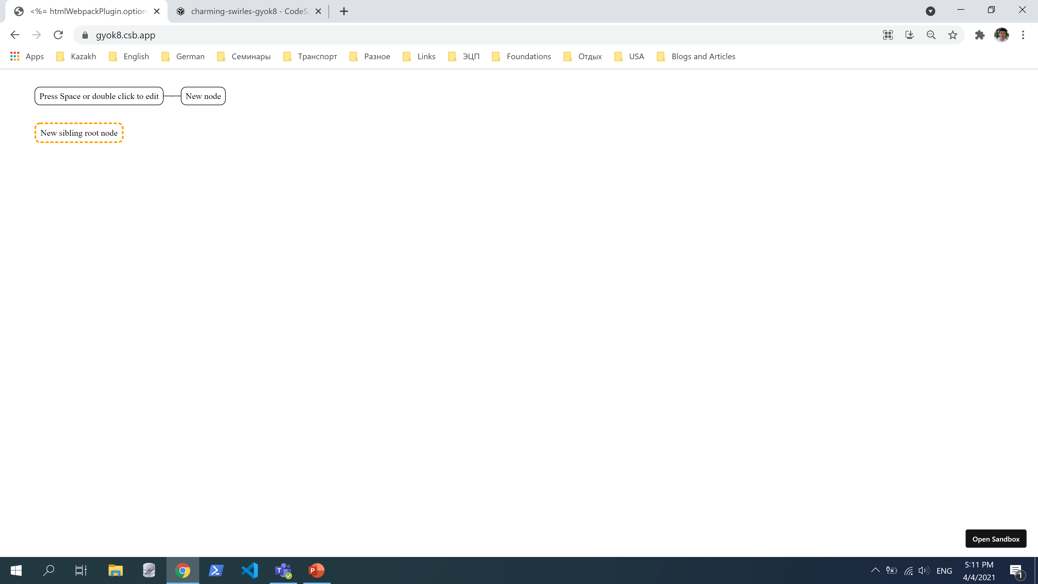
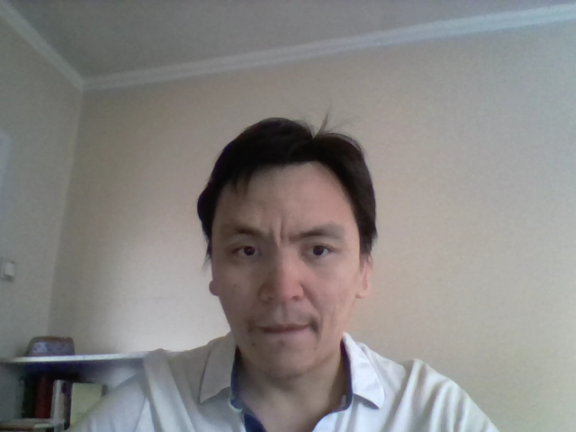

Create sibling nodes using keyboard Enter key

Slide 5
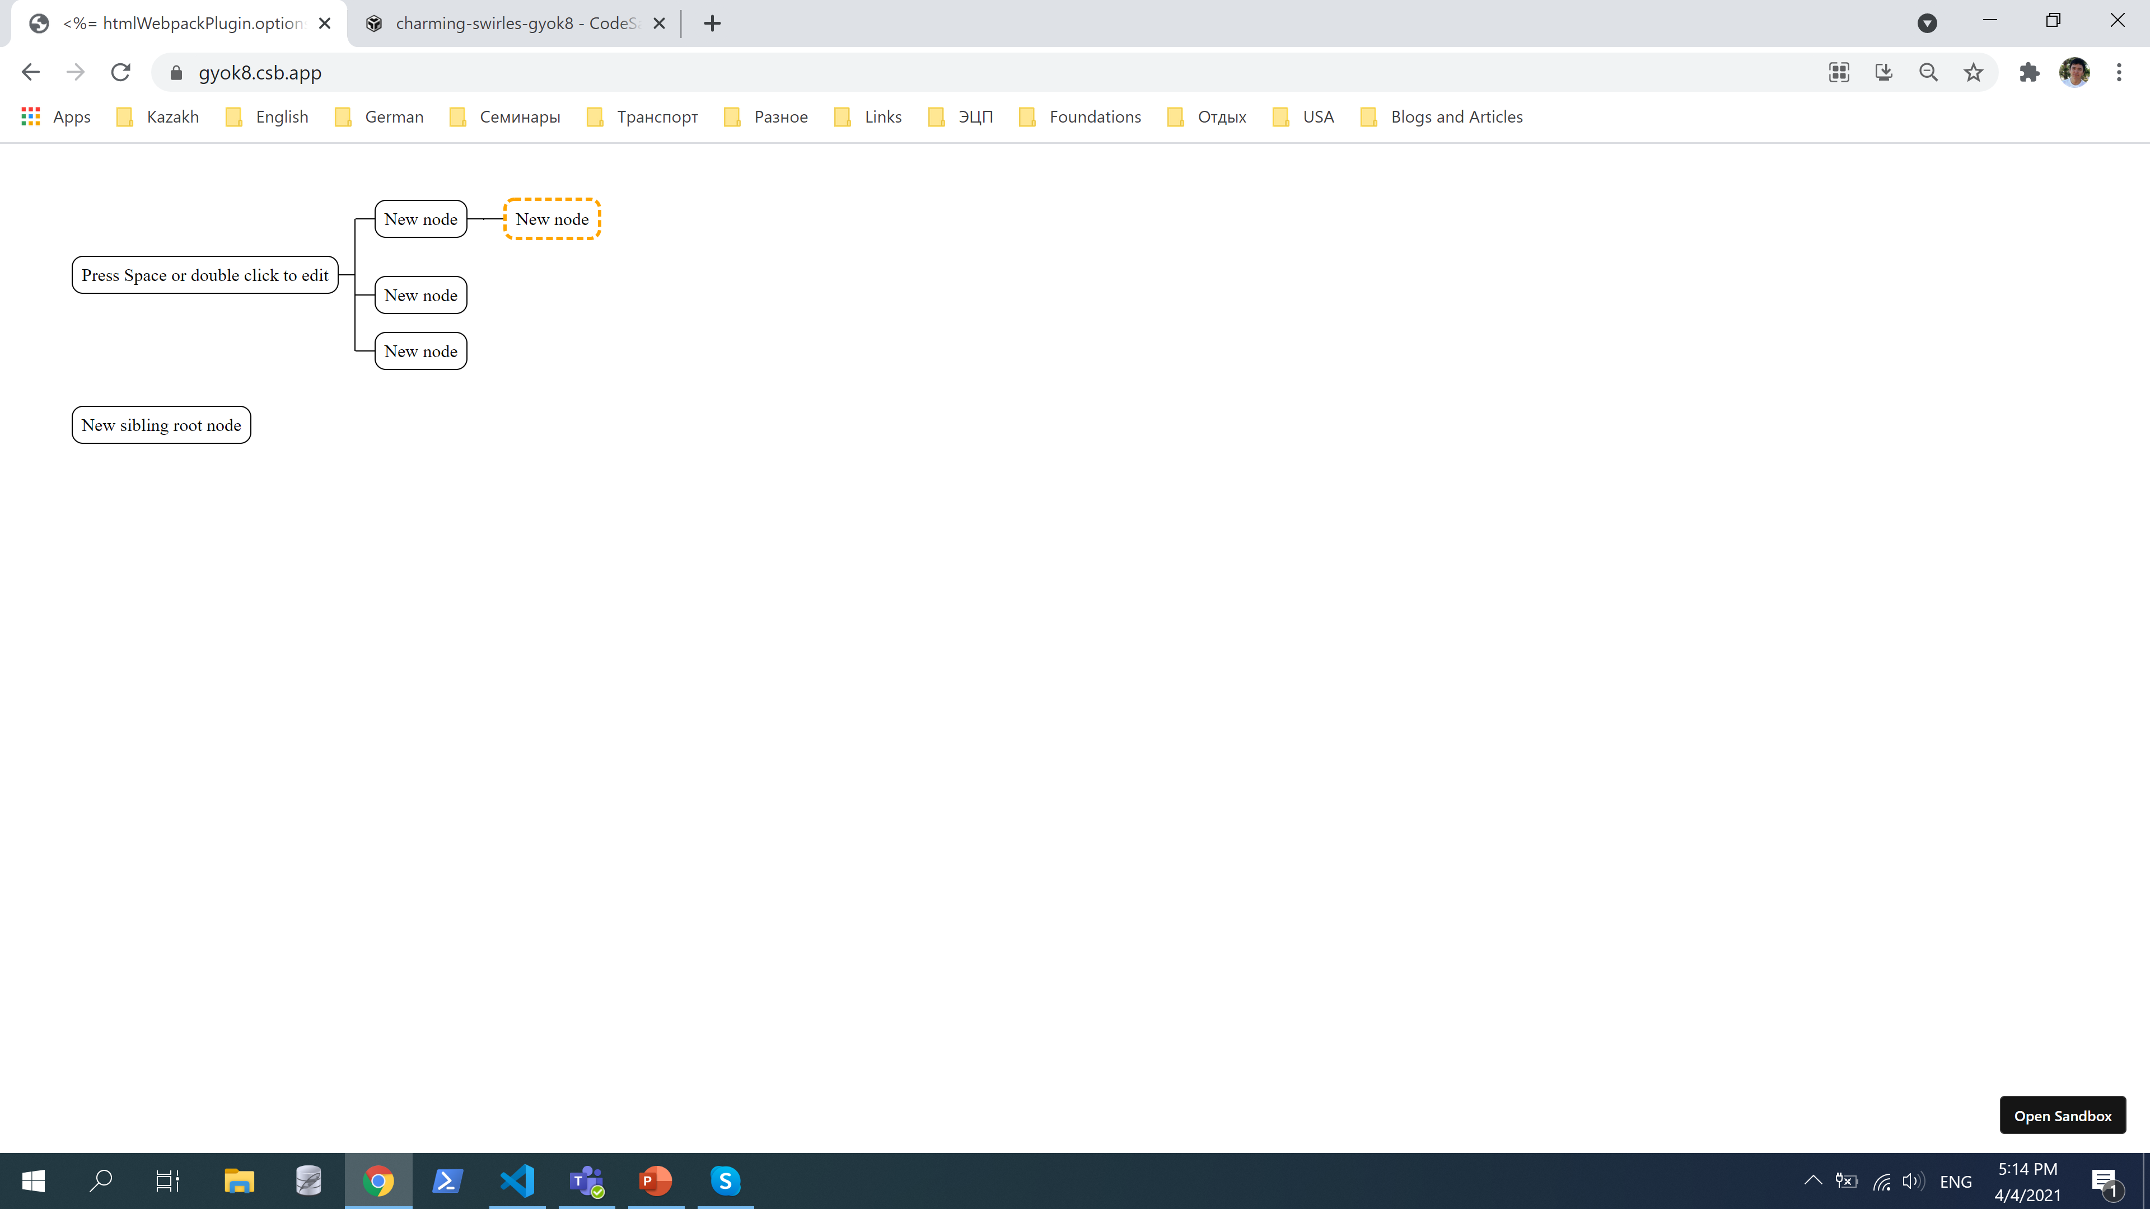

Navigate using keyboard Up/Down/Right/Left keys

Slide 6
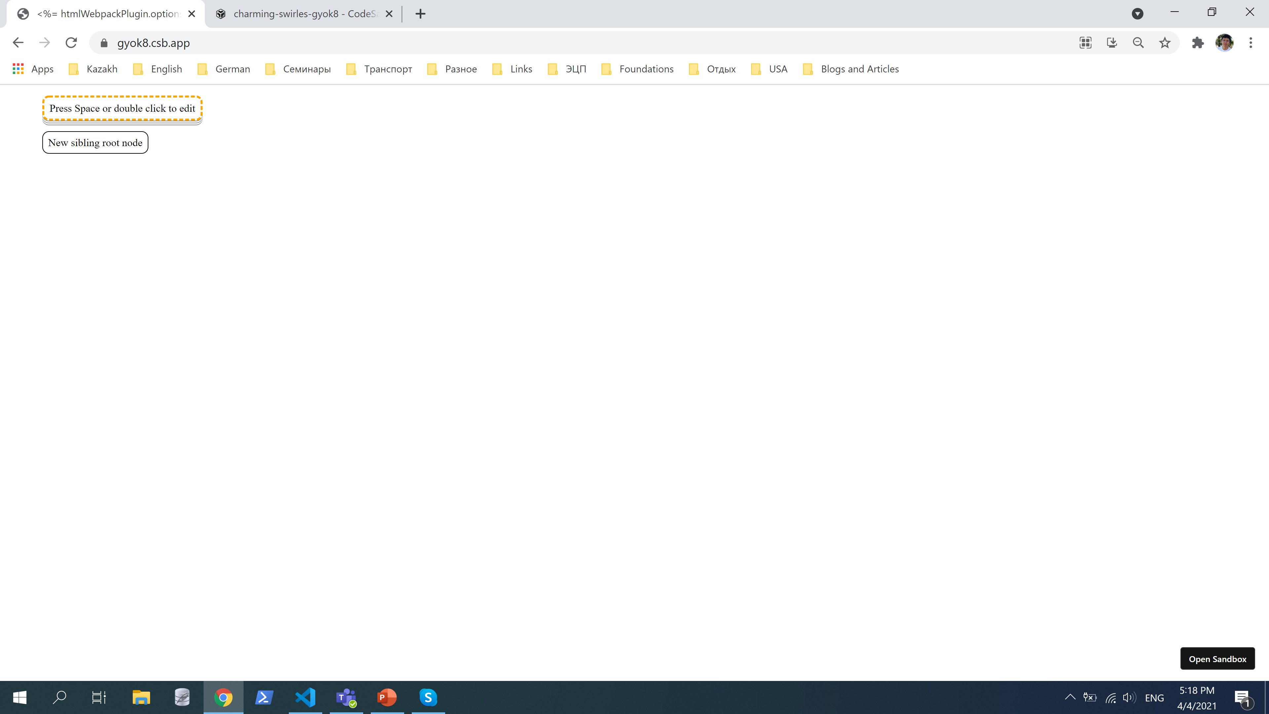
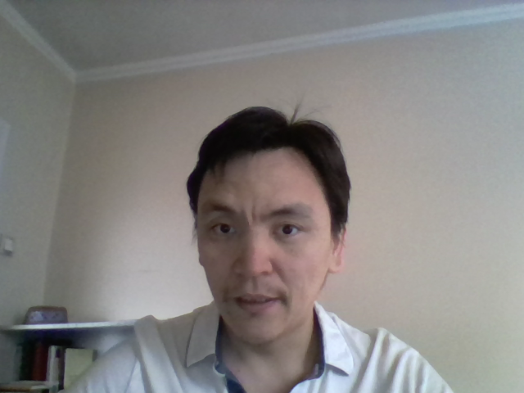
Expand/Collapse using keyboard F key

Slide 7
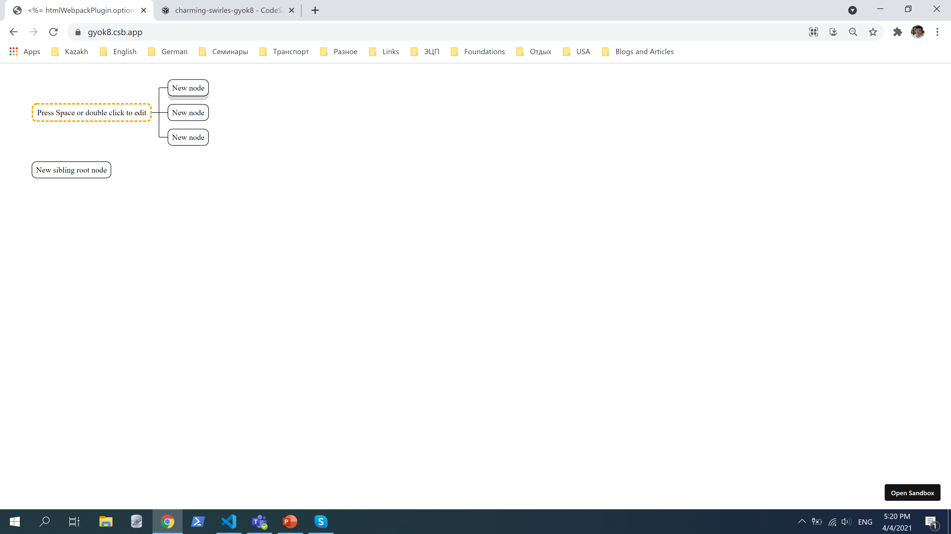
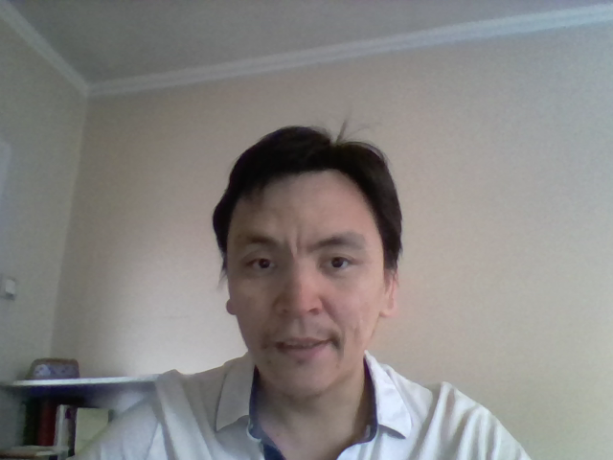

Expand collapse child nodes using keyboard Shift + F key

